Slide 1
CEPT Portal, ECC website and other tools
CEPT Workshop on European Spectrum Management and Numbering
5th April 2016

Slide 2
CEPT portal
One portal: 5 websites (CEPT, CERP, Com-ITU, ECC, ECO)
Main principles apply equally to all sites
Most of the information publicly available
Advanced features restricted to group members
Get a login

Slide 3
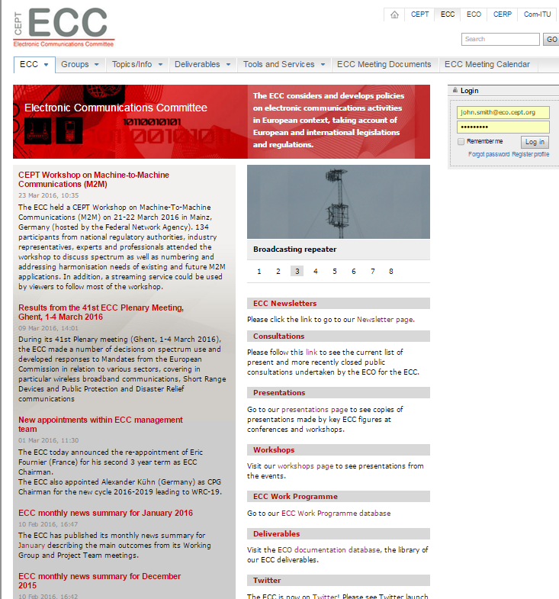
ECC website
Home page: access to news.
Direct links to general information
Newsletters
Consultations
Presentations
Workshops
ECC work programme and deliverables
Twitter
Navigation through tabs

Slide 4
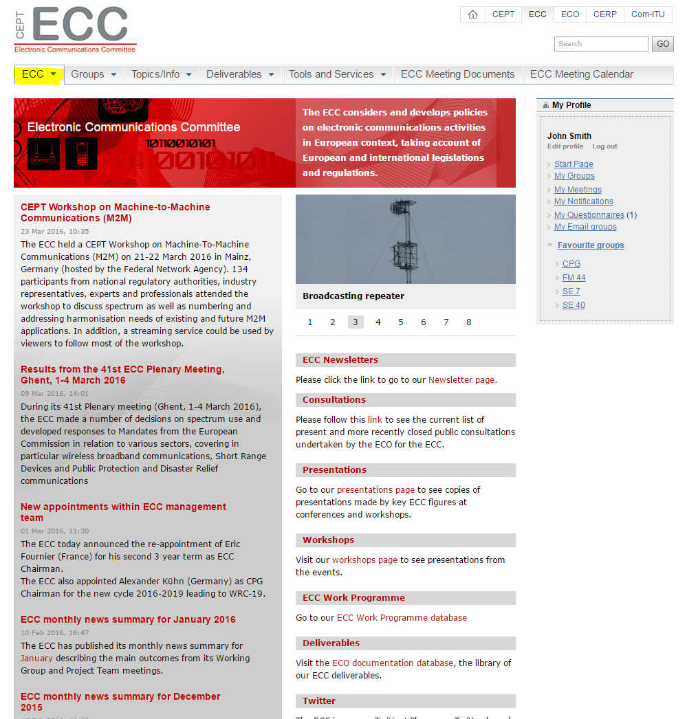
ECC website
ECC tab: Access to general information
ECC mission, framework and structure
Participation, MoU, LoU
Cooperation with ETSI
Newsletters
National contacts

Slide 5
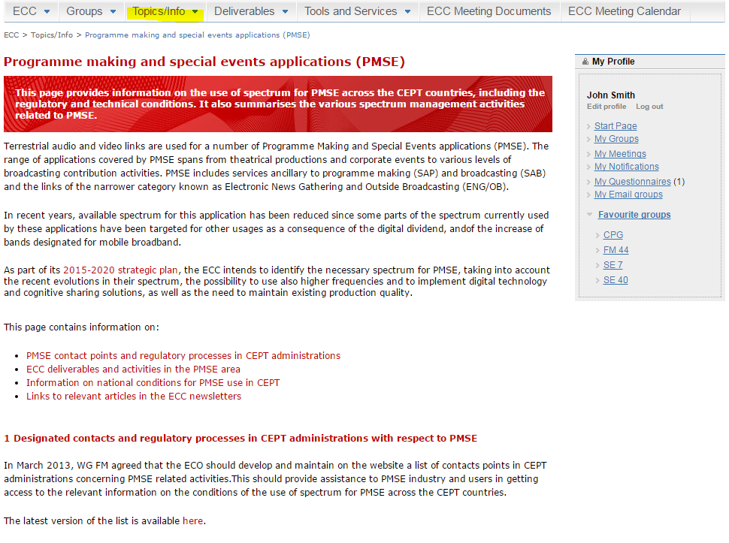
ECC website - topics
Topics
Source of information (deliverables, national contact and information, relevant activities…) on many topics
PMSE
PPDR
Satellite regulatory information
Research activities
Numbering
Maritime communications…
Will be restructured soon

Slide 6
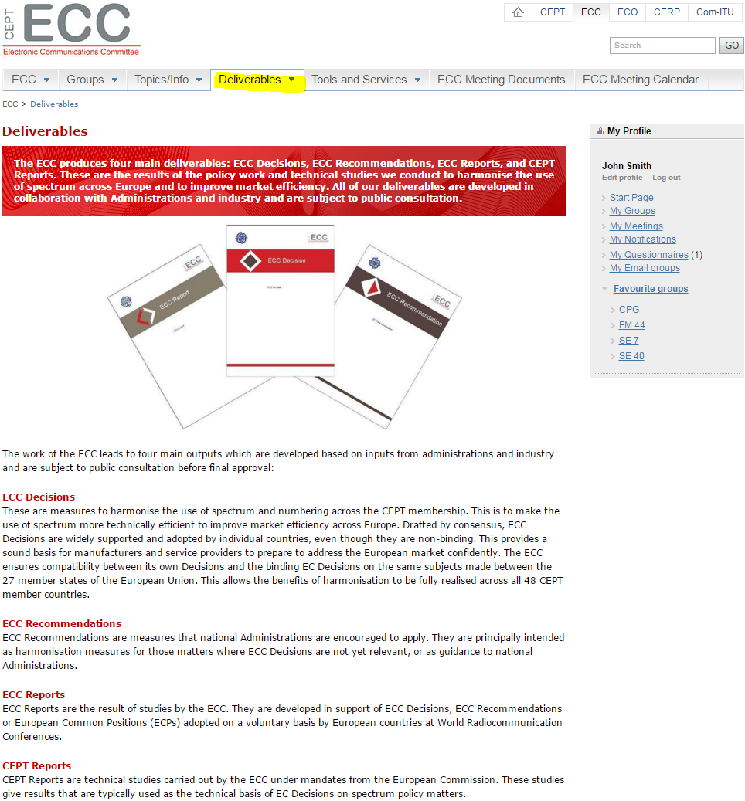
ECC website - deliverables
Deliverables:
Access to ECO documentation database (ECO Doc DB)
ECC Decision, ECC Recommendation, ECC Report, CEPT Reports
New Doc DB under development
Other deliverables
ECO Reports
Agreements
ECC templates

Slide 7
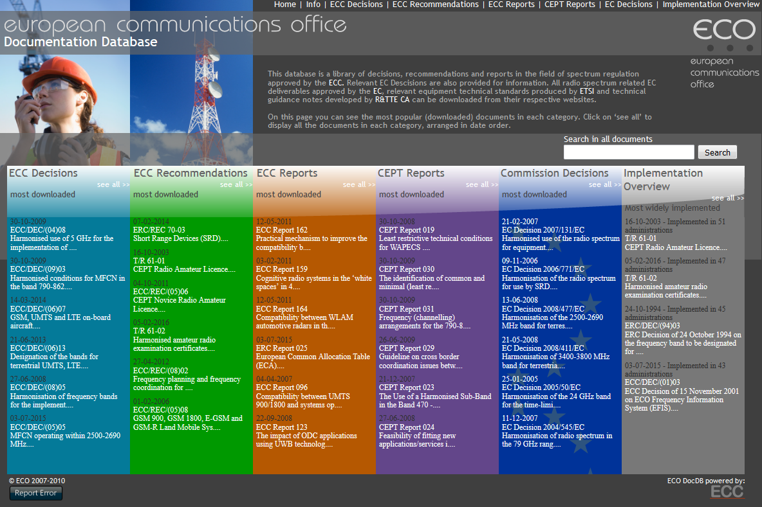
ECO DocDB

Slide 8
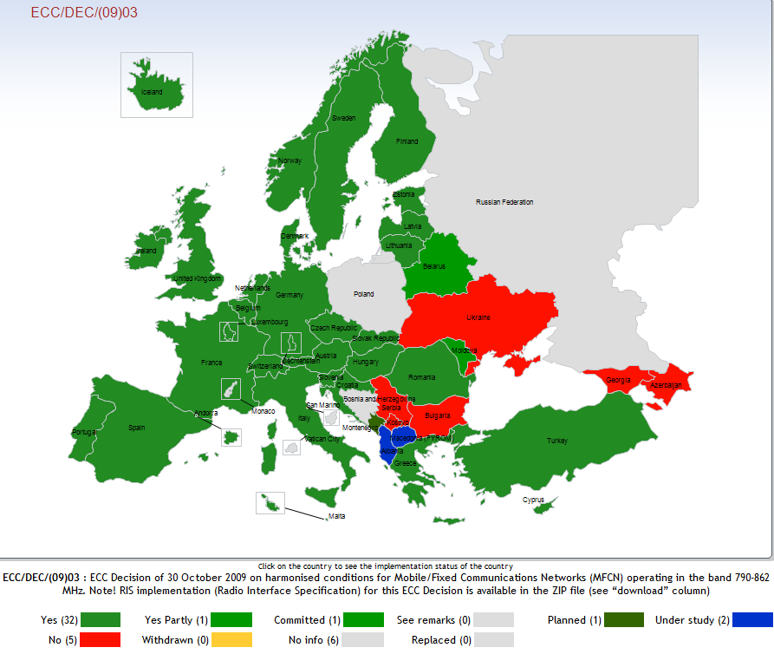
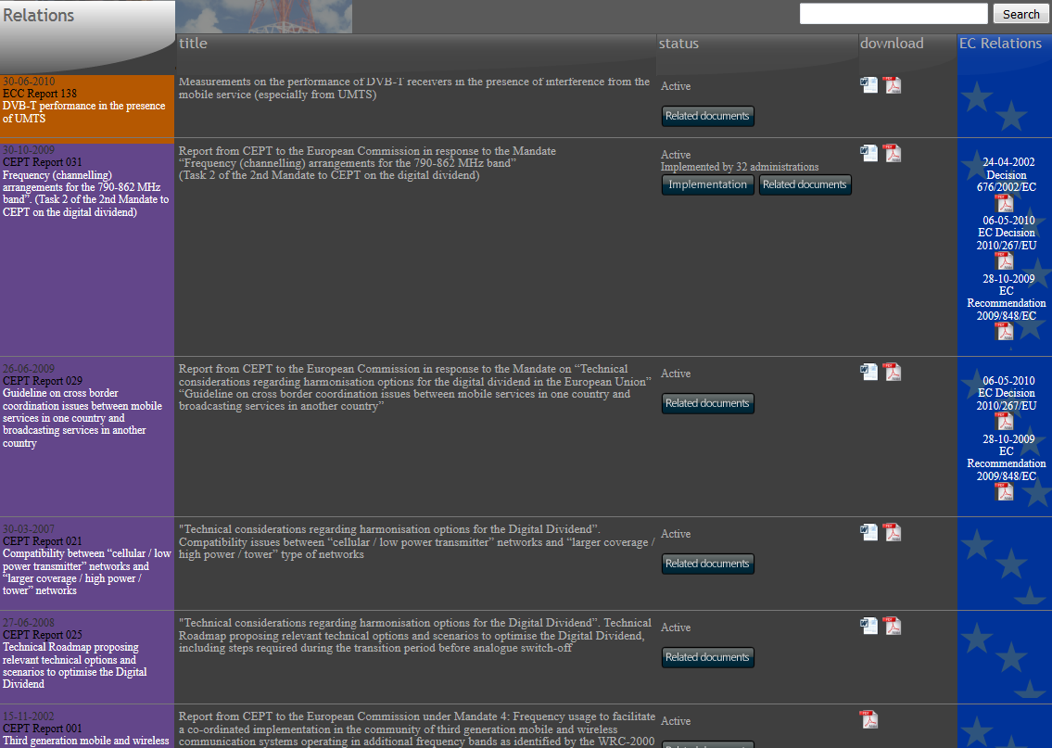
ECO DocDB

Slide 9
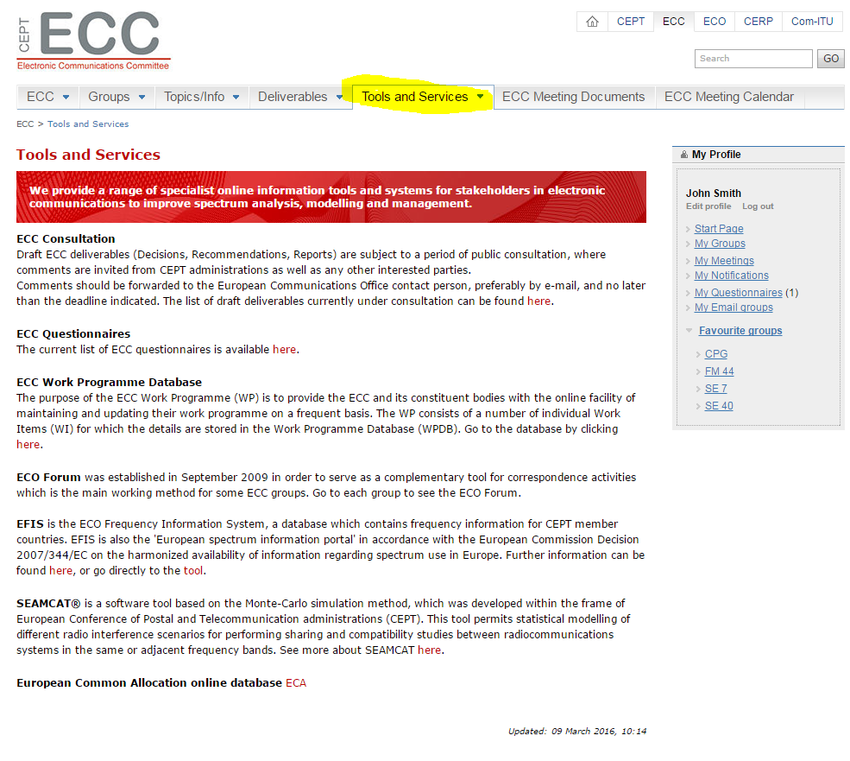
ECC website – Tools and Services
Tools and services
Access to ECO online tools
EFIS
SEAMCAT
ECC work programme database
700 MHz information repository
Other services
ECC consultation
ECC questionnaires
ECO circular letters

Slide 10
ECC Work Programme database

Slide 11
ECC work programme database
New functions
Search function on key words
Gantt chart function to view timetable for selected work items

Slide 12
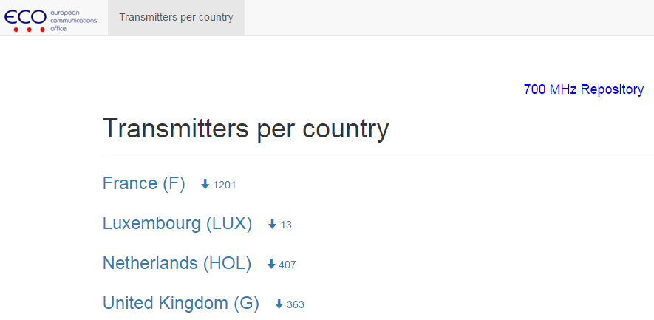
ECC 700 MHz information repository
Displays information provided by administrations about the coordination status of their transmitters in the 700 MHz band items

Slide 13
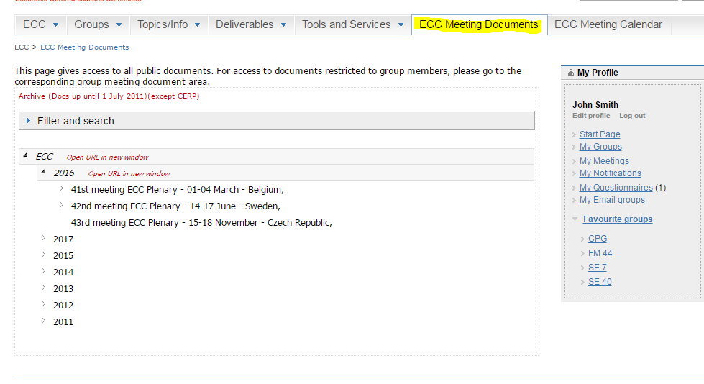
ECC website – Meeting Documents
ECC Meeting documents
Gives access to all public meeting documents.
Filtering and search functions
For access to documents restricted to group members, please go to the corresponding group meeting document

Slide 14
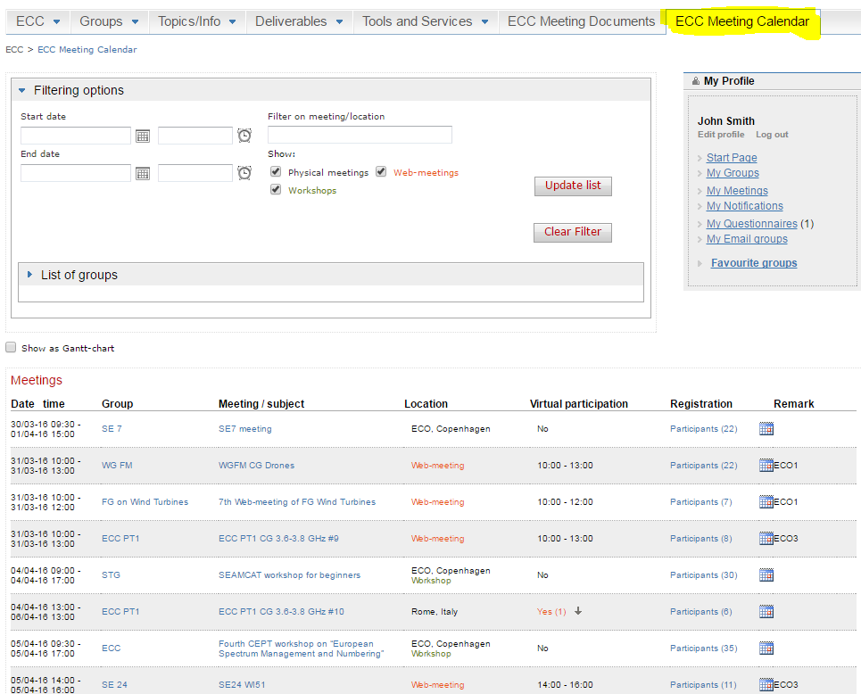
ECC website – Meeting calendar
ECC Meeting calendar
Gives access to all meeting within the ECC
Includes webmeeting
Filtering and search functions
Meeting details
Registration online

Slide 15
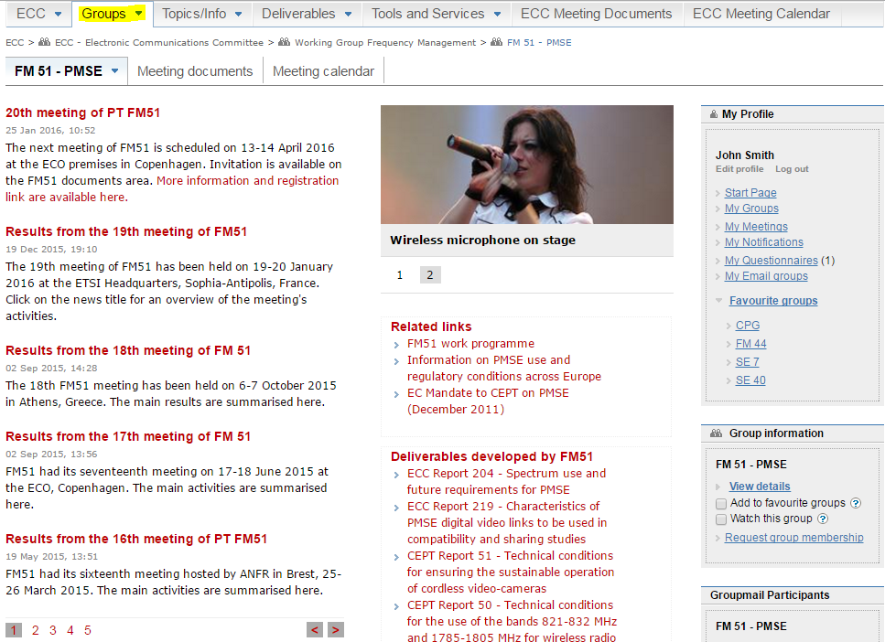
ECC website – Group pages
Group page
Each group within the ECC structure has its own page and framework
Group specific news
Helpful information
Meeting documents
Meeting calendar
Special feature for group members
Interested in a group? Apply for membership

Slide 16
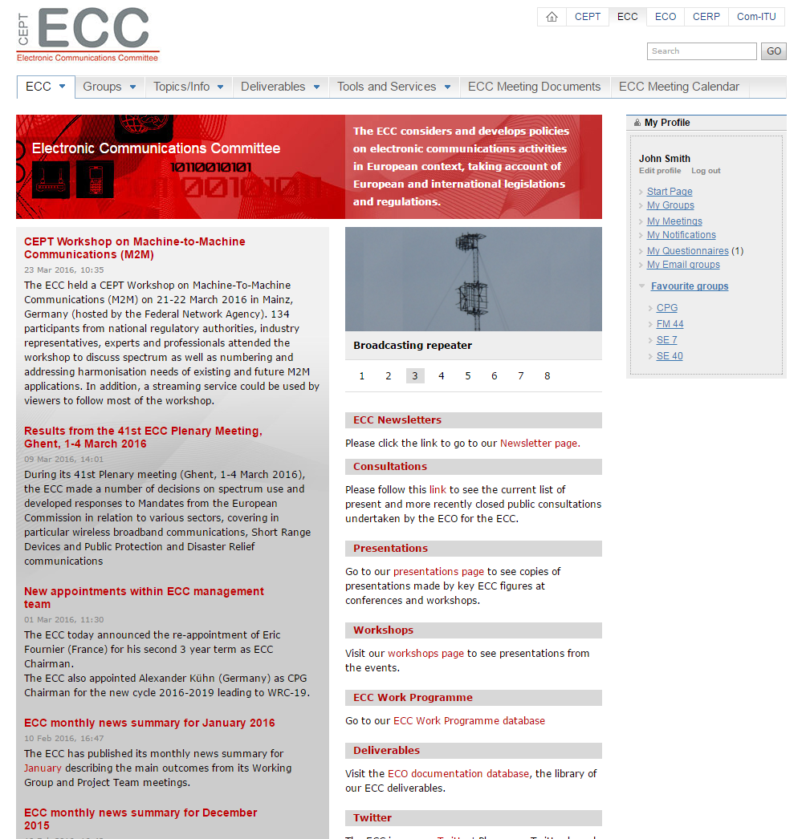
CEPT portal – logged in user
Once logged in, easy access to your important information

Slide 17
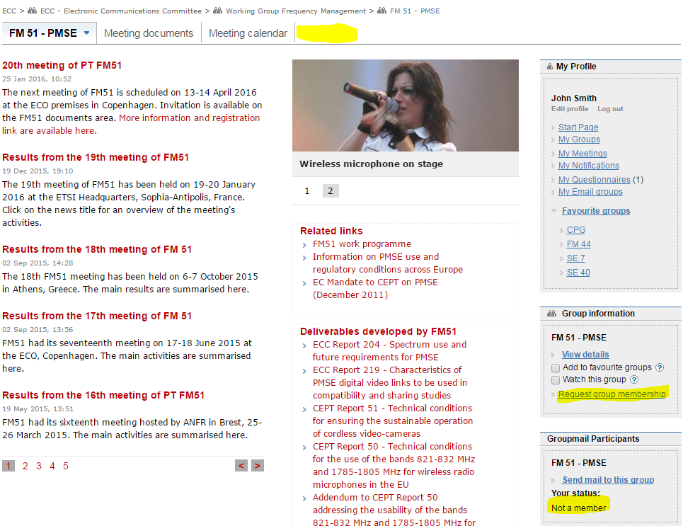
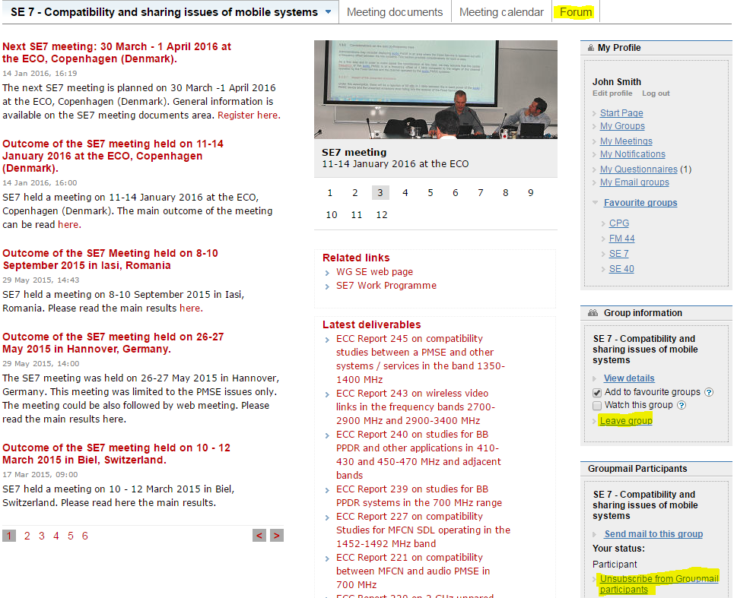
CEPT portal – group membership
Not Member
Member

Slide 18
CEPT portal – group membership
Gives you access to group restricted areas: forum, email reflector, some documents
Allows filtering the information according to your interests

Slide 19
CEPT portal – future development
New version of the CEPT portal under development – release planned during Summer 2016
Improvement to design
Responsive layout (tablets, smartphones)
No change to the main features and the content.

Slide 20
Thanks for your attention!!
Questions ??

